Slide 1
Data layer and physical layer
The lecture 7

Slide 2
Layer 2 – The Data Link Layer

Slide 3
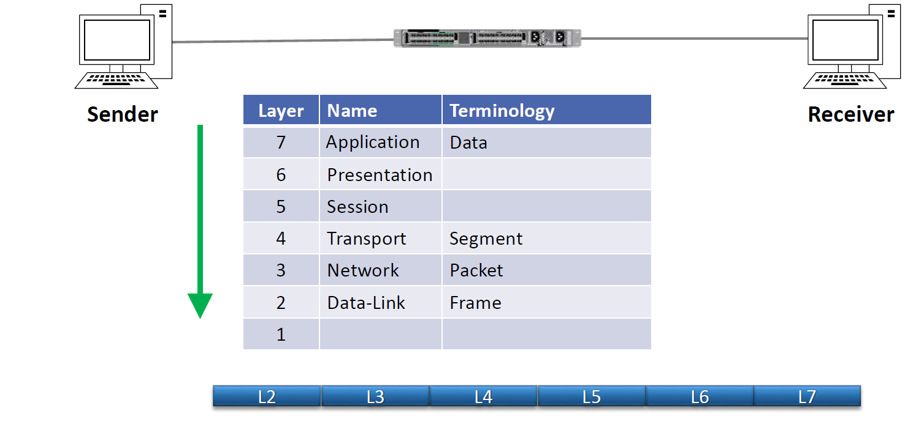
OSI Reference Model - Encapsulation

Slide 4
The Ethernet Header

Slide 5
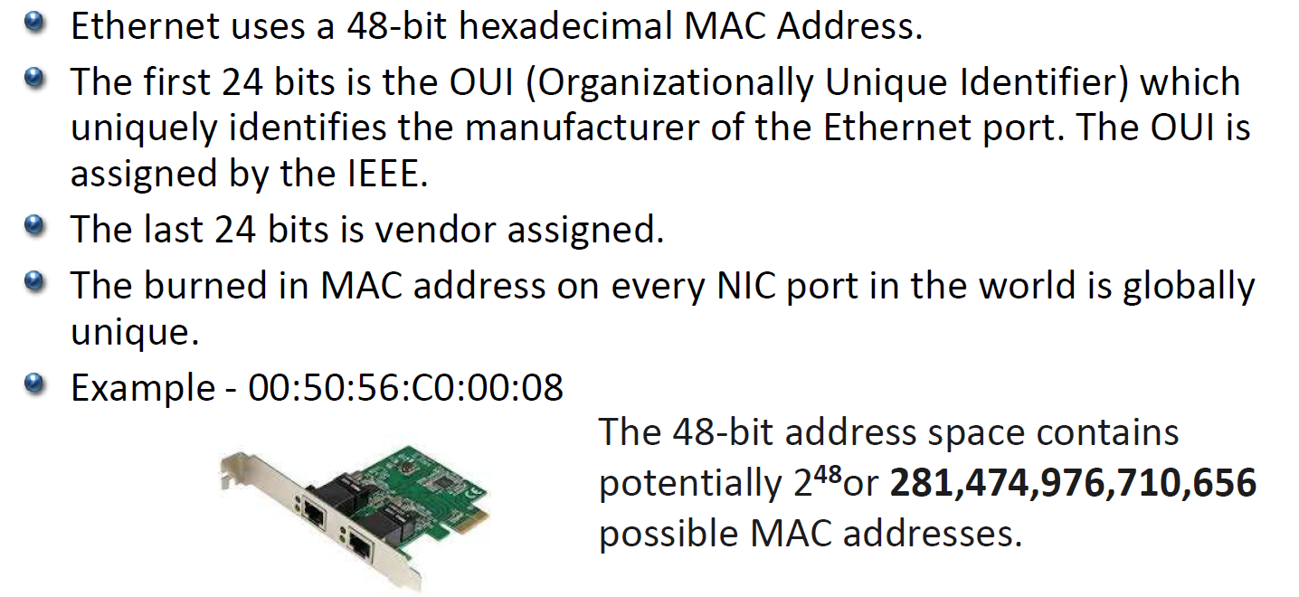
The Media Access Control MAC Address

Slide 6
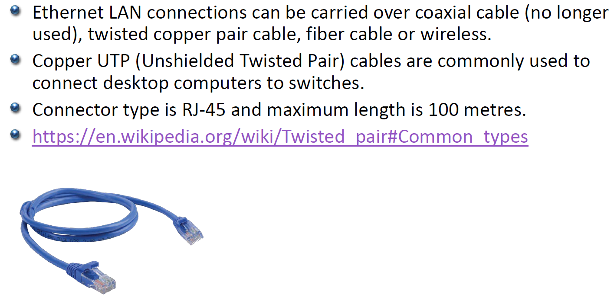
Layer 1 – The Physical Layer

Slide 7
Straight-Through vs Crossover UTP Cable

Slide 8
Fiber Cables

Slide 9
Fiber Connectors

Slide 10
PoE Power over Ethernet

